Slide 1
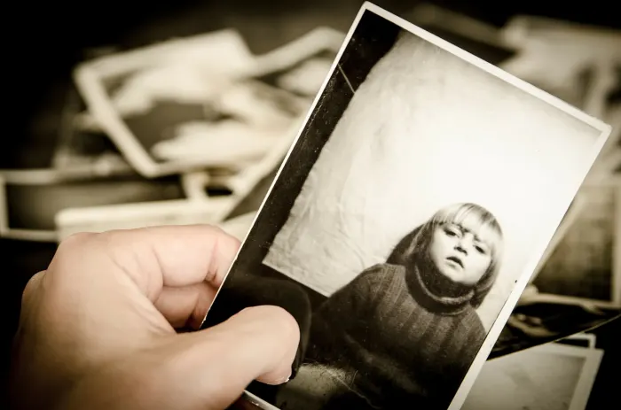
David Kolb (1993), ‘Reflection is integral to learning’
Laura Rendon, contemplative pedagogy
Reflection adds the ‘what I have learned’ to the experience, or ‘how this can change or improve my practice’
Notes:
PROMPT: How can this photo embody a reflective moment? How do you interpret this photo of a person holding a photograph?
The holder of the photograph is perhaps the key figure for the reflective moment: how so?
Think for a minute, make up a narrative/interpretation, share, and then we’ll share some together.
Then the three animations? Kolb, then Rendon (reflection not just for the student learning, but for the faculty teaching). Then reflection is value-added. It can resonate to our core.
Photo-256884-12 CC0 Public Domain via Pixaby

Slide 2
Meauxmentum Scholar Reflections: Your First Draft
Jeffery Galle, Ph.D.
Creative Engagement with Faculty
ellag55@gmail.com
https://Jgalle.com (website),
April 2025

Slide 3
Today’s Purpose & Tasks
To introduce/review the template for reflections contained in the Toolkit
Through conversation and brief writing tasks, we will produce an idea outline draft of the Reflection
Notes:
We have said since January that we’re not at the same place in the MS project, and to be clear the due date of June 2nd takes this into account. So MS have up to two months to complete the work of individual learning. Hopefully many/most can be completed well before that time, but feel free to use all the available time.

Slide 4
From the August meeting and the Toolkit
“By the end of spring semester, each MS and FLC participant should be able to point to a change or innovation they have made in their classroom or on their syllabus to an assignment, activity, or course material as a result of their participation in the FLC.” (p. 1)
Sending the following list of 8 topics to your members will help you . . .
Notes:
Does each member have to do this ‘change in classroom’? YES. May MS organize/collate, YES.
A very few MS have special topics supported by their administration—AI policy and corequisite FLC. Still these can align with change in the classroom in many ways.

Slide 5
8 Connected Topics for Reflections
A brief description of the original assignment, activity, or course material.
The purpose of the assignment, activity, or course material. (aka a TiLT term)
A description of the change or innovation you have made to the assignment, activity, or course material.
What you hoped to accomplish with this change or innovation (i.e. your goal).
Did this change or innovation meet your expectations?
What was the outcome for your students?
What will you retain or do differently next time?
What effect did your participation in this FLC have on your teaching?
Notes:
The quickest way to uncover what we know and what we think about a topic is the 60second DASH with each of the topics in succession.
Ready?
Then with your neighbor, address one or more of the following: (1)what was successful, (2)what was neglected, (3)where are we in the process?
Again note: up to TWO more months in the process.

Slide 6
8 Connected Topics for Reflections
A brief description of the original assignment, activity, or course material.
The purpose of the assignment, activity, or course material. (aka a TiLT term)
A description of the change or innovation you have made to the assignment, activity, or course material.
What you hoped to accomplish with this change or innovation (i.e. your goal).
Did this change or innovation meet your expectations?
What was the outcome for your students?
What will you retain or do differently next time?
What effect did your participation in this FLC have on your teaching?
Notes:
The quickest way to uncover what we know and what we think about a topic is the 60second DASH with each of the topics in succession.
Ready? [App 10 minutes of writing altogether]
Then with your neighbor, address one or more of the following: (1)which topics were easy to respond to, (2)what was neglected, (3)what occurred to as you wrote?
Again note: up to TWO more months in the process.

Slide 7
Share
Which questions/topics were easy to answer quickly?
Did one or more remain unanswered?
Which one or two are the most important?
Notes:
Now, with your neighbor, address one or more of the following: (1)which topics were easy to respond to, (2)what was neglected, (3)what occurred to as you wrote?
Again note: up to TWO more months in the process.

Slide 8
New Assignments, Course, Curricular Materials
--Holmes: Writing Intensive assn, Community based project with nonprofit, site visit to legislature to observe, producing a persuasive letter/paper designed to support effort of nonprofit (Georgia State U)
--Employ ‘pause-predict-ponder’ to encourage constructive guessing (Ga Tech Engineering)
--Spliced in new topic in MGIS and away from block class (Dalton State Information Sys)
--Creating Concept Map to connect previous to current materials (Dalton State biology)
--TiLT-ed nursing assignments to create new assignments (Ga Southwestern nursing)
--Produced a model Capstone (HIP) for the university (U of West Georgia, all programs)
--Produced pilot syllabi for an FYS (HIP) course to be offered (Valdosta, all programs)
--Pool of 120 questions to support 6 quizzes using SWEBOK (Ga Tech Engineering)
Notes:
For me, everything we have done hinges on specific course changes. The center of the FLC program is the course change (#3), from pedagogical strategies.
These new Course Changes, taken from pp. 78-89 of Galle and Domizi Faculty Learning Communities (2021), which was one of two books emerging from the FLC project run by Georgia’s Board of Regents from 2018-2022. So each of the changes emerged from one professor’s participation in a learning community at the mentioned university.
At edge of a very deep pool filled with new activities, assignments, even new curricular and modal possibilities.
Now, let’s choose ONE of these examples and see what happens when we look at the other topics?

Slide 9
Unpacking the Topics
Original
So what was the original assignment which the above ones replaced? Is the new something novel, was it something needed to fill an absence or deficiency, was it an experiment in using class time to enhance student learning or engagement, or again, something different from all the above
Purpose of original
And what was the original one designed to do? Was the answer in the syllabus? Again, was the purpose specified or not?
Notes:
Now, let’s look at some successful examples of each topic. NOTE: The examples are on the Regents site for the examples.

Slide 10
Unpacking the Topics
The Change
--Holmes (Writing Intensive assn, Community based project with nonprofit, site visit to legislature to observe, producing a persuasive letter/paper designed to support effort of nonprofit.
The Goal of the Change
Typically, the goal of the change is to remedy a stumbling point for students, deepen learning of critical materials, or another challenge. Or as Holmes did: Holmes created an entirely experiential learning project out of her persuasive writing course.

Slide 11
Unpacking the Topics
Meet expectations
Rarely are professors perfectly happy nor do they remain as amazed as they were in first applications. Hence, course change is iterative but progress is generally clear.
Outcome of change for students
The data can be quantifiable or qualitative, so specified in some chart or could be a narrative of impact by interviewing students. Or anticipated impact if necessary.
Retain, do differently
Most answers here show analysis of the course change impact on students and include one or more modifications for succeeding courses or semesters. See note above.

Slide 12
Final Topic: Impact of FLC on my teaching
--Holmes: Several participants are coauthoring a book chapter with me, and I’m excited to further reflect on our experiences through that scholarly contribution.
--the most impactful prof dev [program] in my teaching at Ga Tech
--Several of us are presenting at conference in the fall.
--Totally redesigned not just the course I based the course change on but all of them
--My two years as a Learning Scholar have led to new opportunities in my institution.
--I am finally getting closer to seeing the potential of my students realized.
--Inviting students to contribute to course materials has been an amazing change.
--Want to thank the USG for supporting us through this program.

Slide 13
II. Planning, Writing, Sharing
10 minutes planning time. Your course change as basis, organize the 8 topics into outline. Add placeholder for intro, thesis, and conclusion.
15-20 minutes writing time for details and to address topics unaddressed.
15-20 minutes sharing with a colleague. What do you envision? Here are my questions. Report to full group.
Notes:
So let’s get to work on YOUR Reflection essay. This is an overview slide for the second hour: Plan and outline, more writing, and then share what you have with a colleague.
PLAN: For me planning is outlining, thinking of what-it this first and so on? Measure twice, cut once. A first good step for 15-20 minutes, and using your notes from the brainstorm/dash, organize the 8 topics in the best way for you, add a placeholder for Introduction, perhaps a thesis statement, and placeholder for conclusion. Note that I moved the 8 topics into a different order to suit my presentation here. Write out as much new detail on each as you can at this point and no matter if it’s sketchy at this point.

Slide 14
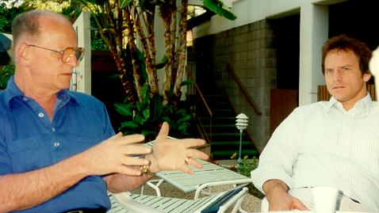
Planning, Writing, Sharing
Notes:
Share process. Share the details of what you have produced thus far.
At end of second hour here, we’ll take a 10 minute BREAK before returning for the third hour on the Reflective mode.

Slide 15
III. Contributions of FLC Members
Imagine you have the written contributions from all community members. What will it take for you to collate or integrate them?
[from Toolkit] Members will describe a course change, its application, and how FLC experience changed their teaching.

Slide 16
Collating or Editing Member Reflections
Collating
Sending out a call for reflections with an example attached. Then taking them as they are and put them in your Reflection as their independent work or contribution.
Editing member submissions
Gather the member contributions: course change, outcome, and reflection on impact on their teaching. Summarize that work, select key points, add quotes.
Notes:
Discuss challenges, offer examples here too. For those who have not asked members to contribute, write them asking how they are using the materials, strategies, activities? Ask them, and generally that alone leads to good materials. If you are still meeting the FLC, great! Plan ahead.

Slide 17
Ways to Showcase Member Reflections
Collating:
• Ashley Holmes (HIPS)
• Mary Hocks
• Gina Caison
• Matt Dischinger
• LeeAnne Richardson
• Michael Harker
• Melissa McLeod
Editing/summarizing:
Sarah Selby writes entire report (Small Teaching) and takes brief submissions from each member and summarizes while also adding good quotes.

Slide 18
Reflection is Experience-plus
15-20 minutes writing your MS experience:
What you learned in the role of MS: leadership, FLC facilitation, colleagues and their work, and elements involved in student success and learning.
Impact on teaching, attitudes toward pedagogy, the next steps toward new pedagogy or next year’s courses, and learning community leadership and/or participation
Notes:
Photo-256884-12 CC0 Public Domain via Pixaby
The photo we’ve used to represent a reflective moment could here be changed to one of your choosing to represent you, your work over the year. Let’s spend some time now writing initial reflections on the year using the questions on the slide as general guides.

Slide 19
Looking ahead
A May TBD 2-hour virtual workshop
Hope to use some of your work as examples for those who could not attend today.

Slide 20
Notes:
Where the essays are heading, first and then hopefully. The first is a Regents publication done by Denise and me; the second is Rowman and Littlefield where I have published a few books. R &L joined Bloomsbury this past year.
Now is first of April. In May, we’ll return to the Reflection report for a second draft that should include segments from your members.
Then by June 2, the report should be final. That gives you about TWO months.

Slide 21
Thank you and please contact me with any questions
Jeffery Galle, Ph.D.
Creative Engagement for Faculty
ellag55@gmail.com
https://Jgalle.com (website)

Slide 22
Report quotes
Selby: The eight participants who submitted reports incorporated changes that ran the gamut of Lang’s structure, from Knowledge to Understanding to Inspiration. Most changes were designed to aid retrieval, make connections, and increase engagement. [Selby summarized reflections of participants]
Abegaz: [provided intro, followed by collation of individual reports. His own report was placed last to provide some overview.

Slide 23
Report quotes 2
See Ashley Holmes’ Reflection. Topic of HIPS and her member Mary Hocks’ conclusion: ‘I can think of no better way to demonstrate the importance of reflecting on our teaching, because this faculty group and my coteaching were essential to my own success as a teacher this year’ (6/13).

Slide 24
Report Sample Course Changes
The sample reflections are worth spending some time reading!
Sara Selby, South Georgia College (facilitator scholar). FLC composed of instructors, primarily. Great overview, details of progress of FLC.
Frank Pridemore, POLI 1101, moved to using 5 bullet points beginning of class, referring to them, asking for recall, rather than straight lecture.
Susan Clement, NURSING 2213, developed a set of questions to be given out at end of class to direct student reading/study. Quiz to begin next class.
Samuel Abegaz, Columbus State (facilitator scholar). ST Online. Overview of his FLC is well done. Note focus on online setting, guest experts, how they do readings, discuss, share plans, & changes.
Florence Wakoko, Sociology 1101, Using Darby and Lang’s ST Online, she created small scallolded assignments that focused on brief tasks the culminated in a larger assignment.
Note: there are almost 20 reflections in just these two reports!

Slide 25
Report Sample Course Changes 2
Goldsberry, Georgia College. Created a TiLT rubric for members to use in revising existing assignments or creating new ones.
Akella, Albany State. Focused on clarity of tasks in two assignments by writing detailed individual paragraphs describing specific tasks and seeking student feedback on them.
Brown, Georgia Gwinnett College. The community produced pre- & post-TiLTed assignments, specifically for an interview with an area expert.

Slide 26
Report Sample Course Changes 3
(facilitator scholar) Amy Sumpter, Georgia College.
For her course Global Connections 2000, struggling to get students to do the readings, she created in class activities where students had to use their readings to build models. Created worksheets and used Padlet as tools for students.
(facilitator scholar) Ashley Holmes, Georgia State University.
For composition English 3020, a course involving persuasive rhetoric, she moved to more writing intensive strategies, a community-based project, and a collaborative group project—three new HIPS in one course.
Mary Hocks, Georgia State University, ‘nothing has been more rewarding than reflecting on my teaching in conversation with colleagues.’ Especially at a research institution, the learning community process has been wonderful.
She added WAC components to a writing course, making it Writing Intensive.

